Slide 1
The Role of Traditional Medicine in Health and Environment.
Presented by:
Dr(MRS) Alka Kharsati

Slide 2
Why Traditional Medicine?
Nature gives us the feeling of peace and tranquility, in that being connected with it heals not only the physical body but also of the mind and the spirit.
The use of medicinal plants in traditional healing gives us the touch of nature in the whole healing process.
In ancient days men came to know about medicine by observing nature.

Slide 3

Is there a place for traditional medicine in today’s health care system?
Take for example what is the first thing you do when you have a sore throat?
Do you go to the doctor?

Slide 4
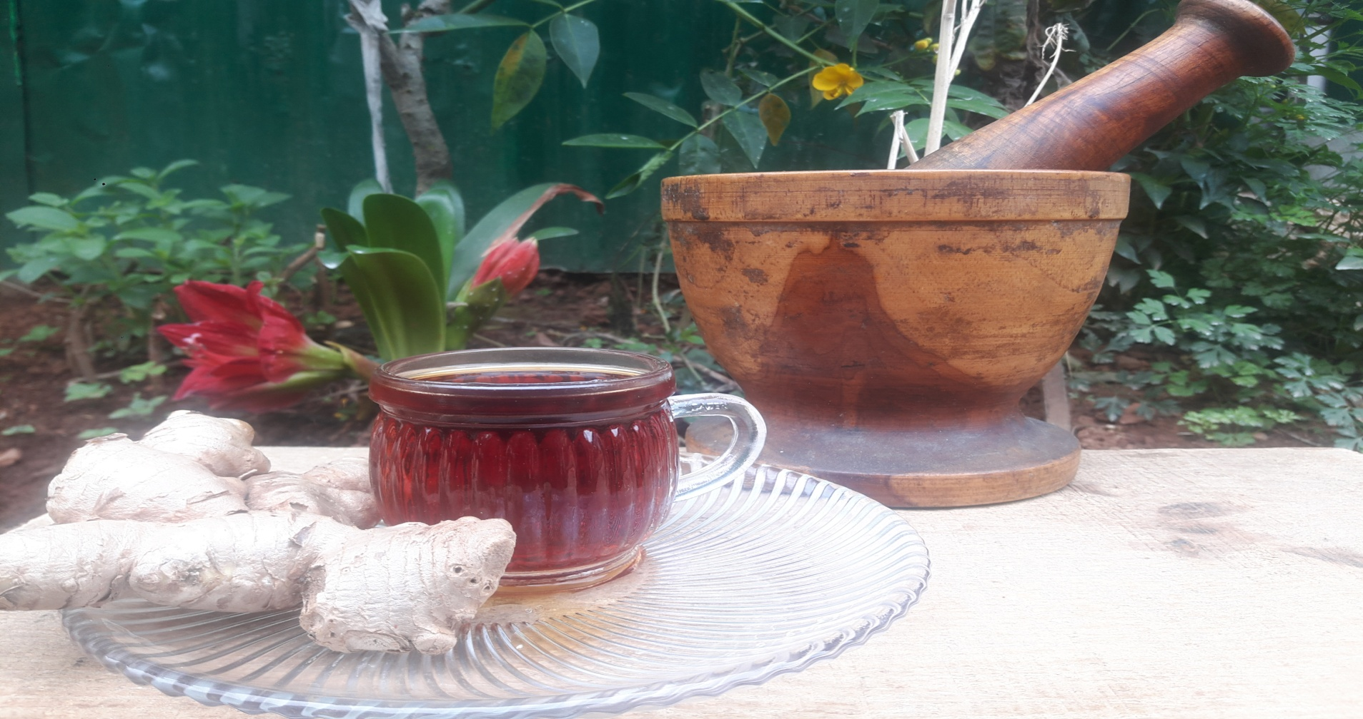
B. You take in warm water or ginger tea?
If your option is B then, it shows that traditional healing still has a place in today’s health care system.

Slide 5
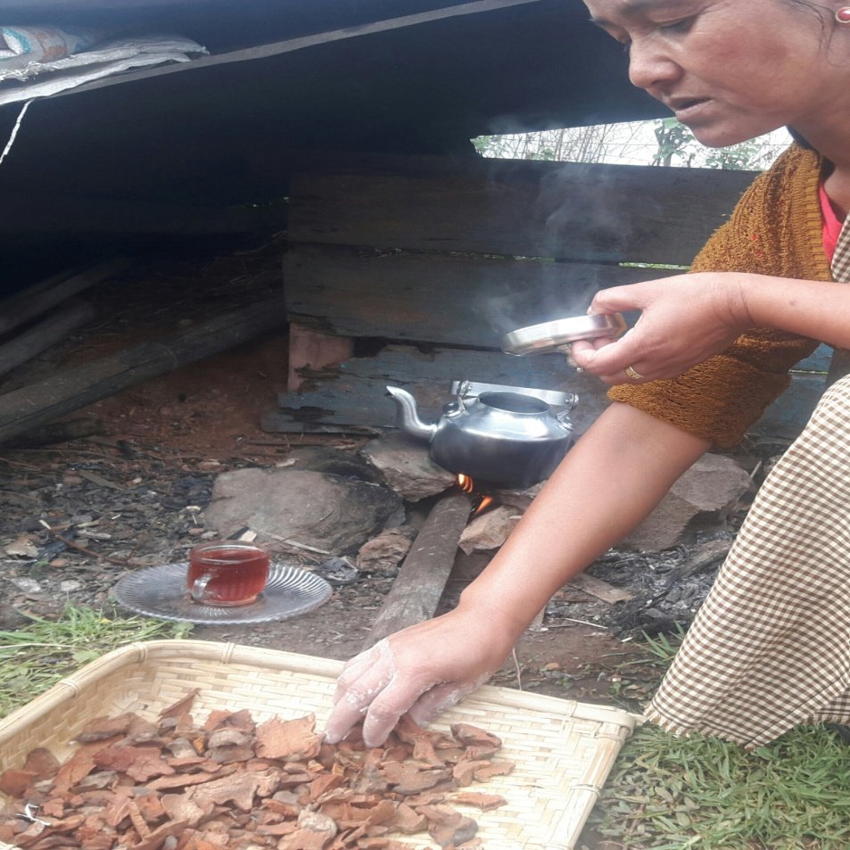
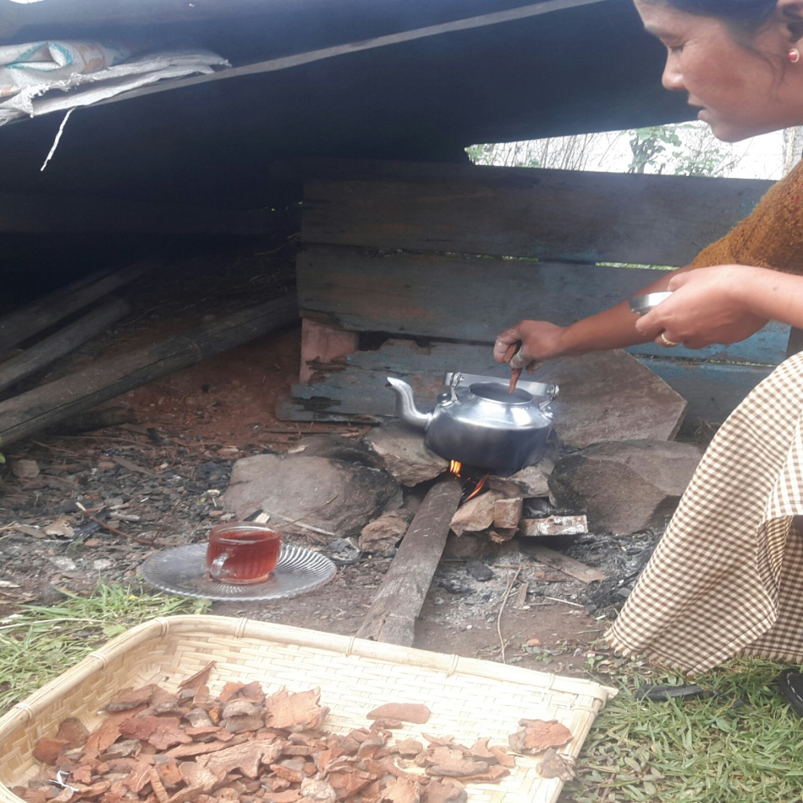
“Sha Shiahkrot”
Health benefits : menstrual cycle, overall health fitness etc.

Slide 6
Traditional medicine and the Environment
In an article special to the Globe and Mail said that “traditional healing seeks to balance the body, mind and the spirit with the environment” (Berube,2015)
The environment plays a big role in traditional medicine.
Due to the environmental changes such as climate change, forest cover etc. the plants that are used in traditional medicines are being endangered .
Most the of the medicines that are used are wildly grown.
We can cultivate them, but it often results in the decrease in the medicinal value.

Slide 7
Therefore you can see how we depend on nature for our medicines and treatment
And any changes in the environment might disturb the population of the herbs

Slide 8
The truth is nature is very important in traditional healing system and without it, IT WILL CEASE TO EXIST..

Slide 9
How can you help?
Everyone can contribute in protecting our forest and the environment around us ,in the simplest way possible.
Afforestation
Waste management.
Conserving natural resources etc.

Slide 10
Thank you.

